Slide 1
Predictive Analytics on Diabetes
Pranshu Tiwari

Slide 2
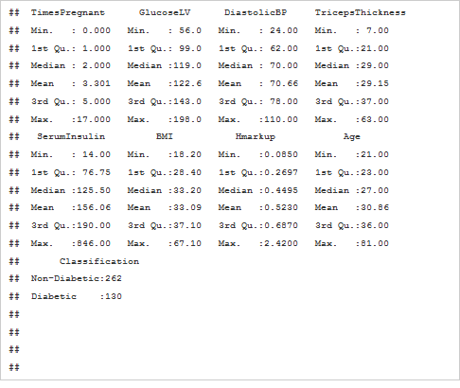
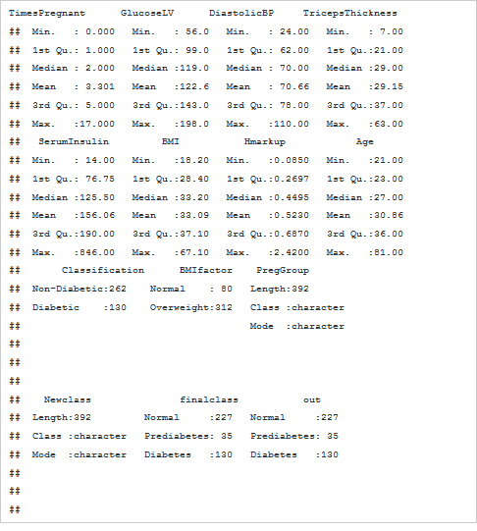
Summary of Data with creation of additional classification variable.

Slide 3
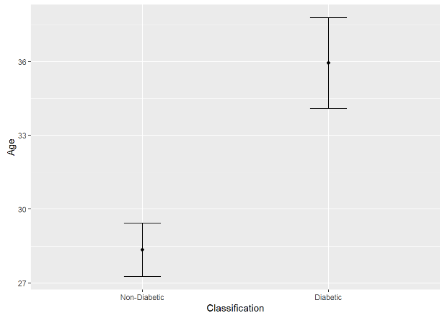
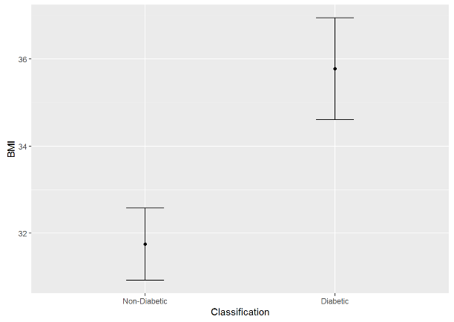
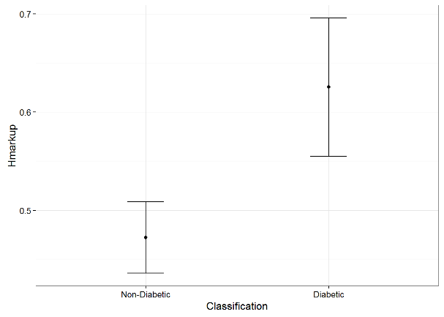
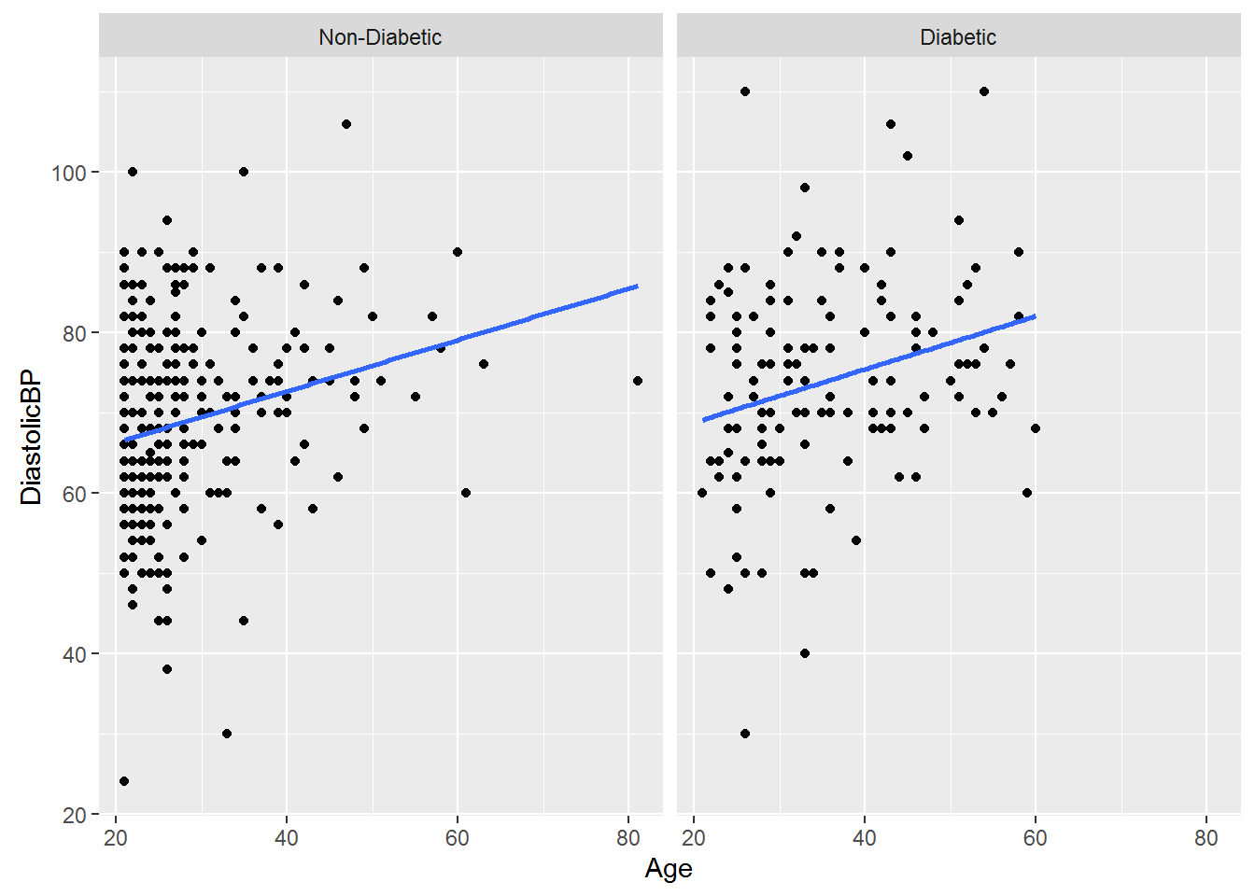
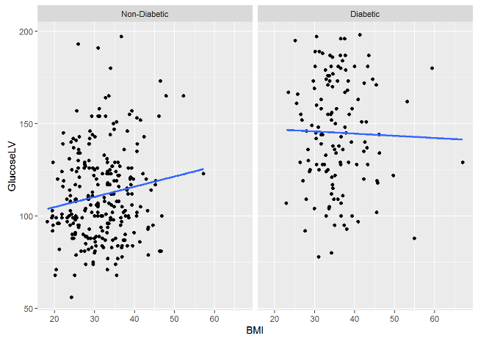
Exploratory Analysis showing BMI, Age & H mark up is significantly higher in Diabetic than non diabetic group

Slide 4
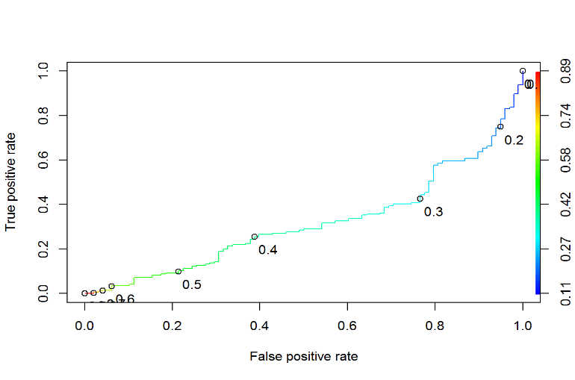
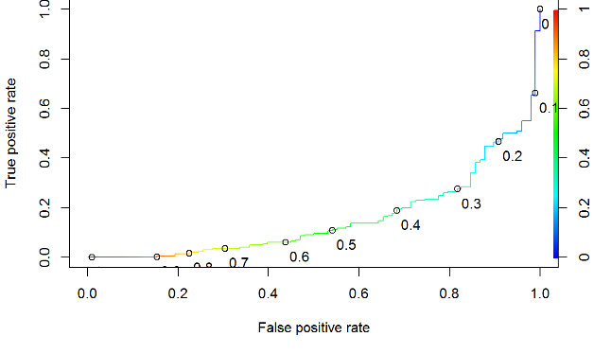
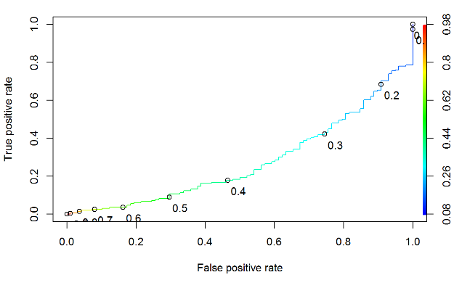
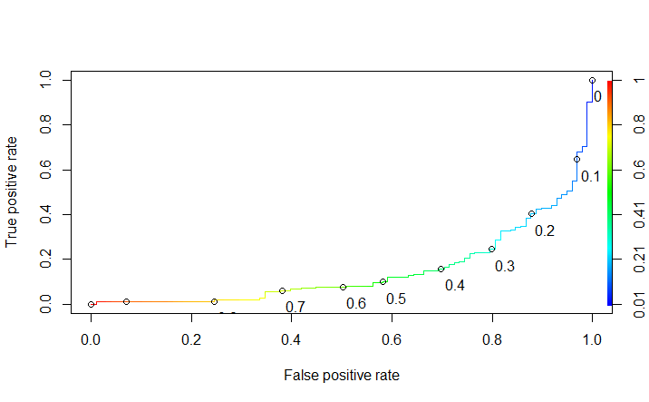
Various Models- Please Refer Paper for Models details
Model 1
Model 2
Model 3-Preferred
Model 4
Model 5

Slide 5
Prediction of Multinomial regression including Pre-diabetes
Actual | Predicted Normal | Predicted Pre-Diabetes | Predicted Diabetes
Normal | 198 | 0 | 29
PreDiabetes | 21 | 0 | 14
Diabetes | 29 | 0 | 65

Slide 6
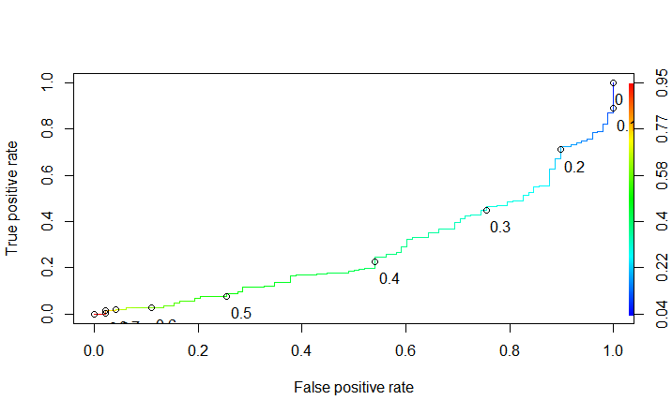
Hypothesis Testing for Model #3
Actual Outcome | Predicted No Diabetes /False | Predicted Diabetes /True
No Diabetes | 18 | 48
Diabetes | 0 | 32

Slide 7
Recommendation
Insurance Companies could use the model 3 with t value 0.15 to identify patients who should have low insurance premium/least suspected patients. This is because the model has highest Sensitivity with a modest specificity as compared to other models. Hence the model will identify subject with less false positive without impacting any True Negative.
Hospitals and health Care companies who wants to target new Diabetic Medicine for high risk group or new Diabetic Campaigns should ensure that campaigns should not target False Positives . They should target patients with critical care and risk. Hence they should use Model 6 with t=0.4 to target definite & High Risk Diabetic patients. This is because model 6 identifies low false positive and hence will identify the worst patients in True Positive group. This is because worst /critical diabetes patients based on this model will help in finding patients who have any significant impact on existing pharmacological treatment
Model 7 is recommended to be used by Healthcare Agencies to identify schemes/plan for Suspects. (Pre-Diabetics who are suspected to be Diabetics). This is because this model identifies Pre-Diabetics which have biological markups similar to Diabetic Patients and hence are high risk suspects

